Slide 1
Solidification of Weld Metal
Lecture 10

Slide 2
Solidification Of Weld Metal
- Solidification process is a type of Phase Transformation
- Phase transformations are not usually instantaneous occurs.
The transformations have two key events(Kinetics):
  1- Nucleation – formation of small clusters of the new phase
  Nucleation – two types:
  Homogeneous nucleation – nuclei of the new phase are formed uniformly throughout the parent or original phase
  Heterogeneous nucleation – nuclei of the new phase form preferentially at heterogeneities (surfaces, impurities, etc.)
  2- Growth – little clusters get bigger
Notes:
End of lecture 1

Slide 4
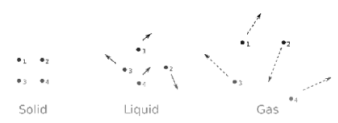
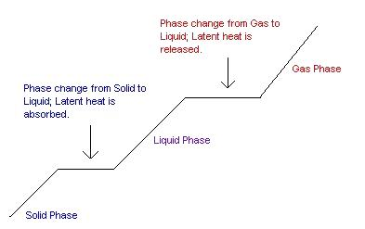
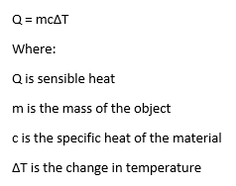
Heating Curve for a Pure Metal
Ql = M * Delta H
Delta H=H3-H2
2
3
Qs = M * C * Delta T
Delta T=T2-T1
1

Slide 5
Fundamentals of solidification of metals
-As soon as heat source moves away during welding , gradually heat is lost to the base metal and Solidification of liquid metal begin.
-Rate of heat lost depends on temperature of weld metal, weld pool size, thickness and thermal properties base metal etc. On cooling, liquid metal losses energy in the form of latent heat and so the temperature is lowered which in turn decreases the average inter-atomic distance between mobile & disordered atoms.
-On further cooling, attractive forces between atoms prevent them moving away from one another and eventually completely liquid to solid transformation takes place.

Slide 6
NUCLEATION AND GROWTH
• Solidification is a result of nucleation and growth
of crystals.
TE= Equilibrium Temp. ≤ Tmelting , T temp. to which weld metal is cooled
5

Slide 7
Effect of Under Cooling (∆T) on Solidified Metal MORPHOLOGY
Two cases:
• T_{transf.} just below T_{E}
--Larger T: diffusion is faster
--Pearlite is coarser.
∆T= TE - T
• T_{transf.} well below T_{E}
--Smaller T: diffusion is slower
--Pearlite is finer.
∆T= TE - T
8

Slide 8
Fundamentals of solidification of metals
-If liquid metal is already carrying solid particles then it will begin to crystallize on them at equilibrium temperature without under-cooling. This phenomenon forms the basis for the heterogeneous nucleation.
-Two conditions should be satisfied by the heterogeneous particles to be an effective nucleate for heterogeneous nucleation.
crystalline similarity between the particles and solidified liquid metal.
difference in lattice size of liquid metal and solid particles should not be greater than 20%.

Slide 9
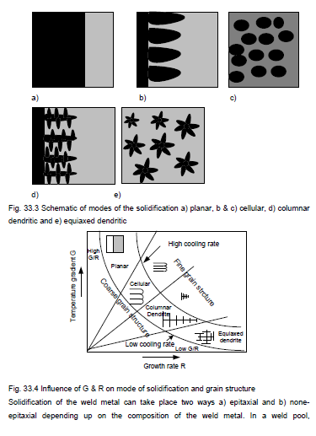
Solidification Modes

Slide 10
Solidification Modes

Slide 11
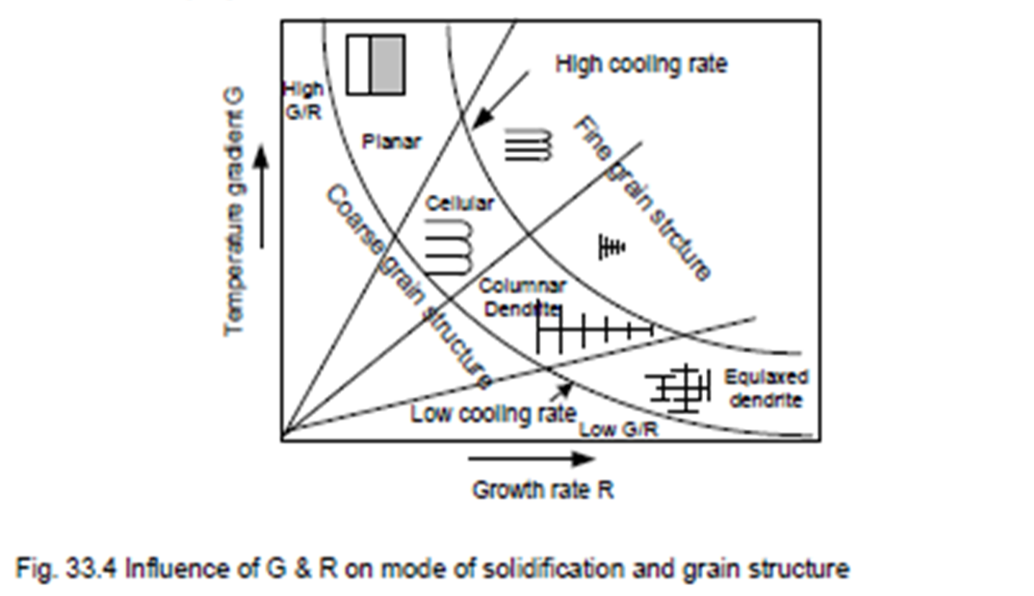
Solidification Modes
-Kinetics of liquid-solid interface is described by the ratio thermal gradient (G) and travel speed of liquid solid interface (R).
-Solidification mode varies as dominating G & R value for given solidification conditions.
-There can be four modes
of the solidification:
planar (high G and
low R),
b) cellular,
c) columnar dendritic,
d) equaixed dendritic
(low G and high R).

Slide 12
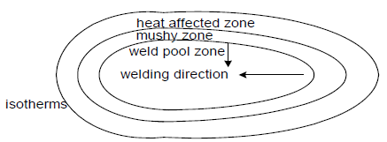
Fundamentals of solidification of metals
-In a weld pool, temperature gradient is clearly observed from the center of the weld pool to fusion boundary of the base metal and iso-thermal temperature lines exist around the weld.
-The peak temperature is found at the center of the weld and then decreases gradually towards weld fusion boundary.
-Grains grow from the fusion boundary towards the weld center. The growth generally occurs at a faster rate in the direction perpendicular to the fusion boundary and opposite to that of the heat flow than other directions.
fusion boundary

Slide 13
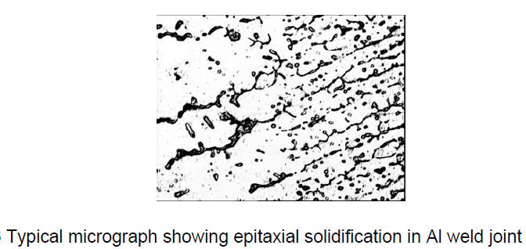
Epitaxial solidification
-Solidification of weld metal can occur either by nucleation and growth mechanisms or directly through growth mechanism depending upon the composition of the filler/electrode metal with respect to base metal composition.
-When composition of the filler/electrode is completely different from the base metal, solidification occurs by nucleation and growth mechanisms e.g. use of nickel electrode for joining steel , otherwise solidification is accompanied by growth mechanism which is known as epitaxial solidification
-

Slide 14
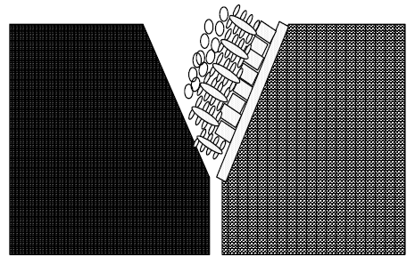
Modes of solidification
-The structure of grain in growth stage is governed mode of solidification (planar, cellular, dendritic, equiaxed) that depends on composition and Thermal conditions determined by heat transfer in weld pool which affect the temperature gradient (G) at solid-liquid metal interface and growth rate of solidification front (R)
mode of solidification (planar, cellular, dendritic, equiaxed) in weld zone

Slide 15
Modes of solidification
-High (G) + low (R) planar solidification
-low (G) + high (R) equiaxed solidification as shown in Fig. 33.8.
-Intermediate G + Intermediate R cellular and dendritic mode of solidification.
-Product of G and R indicates the cooling rate. A high value of G.R produces finer grain structure than low G.R value.
-During welding, weld pool near the fusion boundary experiences high value of G and low value of R
-Weld center experiences low value of G and high value of R
-In fact, G and R varies continuously from the weld fusion boundary to the weld center therefore all common modes of the solidification can be seen in weld metal structure in sequence of planar at the fusion boundary, cellular, dendritic and equiaxed at the weld center. In general, equiaxed grain structure is the most favorable weld structure as it results in best mechanical performance of weld.
-Therefore, attempts are made to achieve the fine equiaxed grain structure in the weld by different approaches namely inoculation, controlled welding parameters and application of external force such as electromagnetic oscillation, arc pulsation, mechanical vibrations etc. In following sections, these approaches will be described in detail.

Slide 16
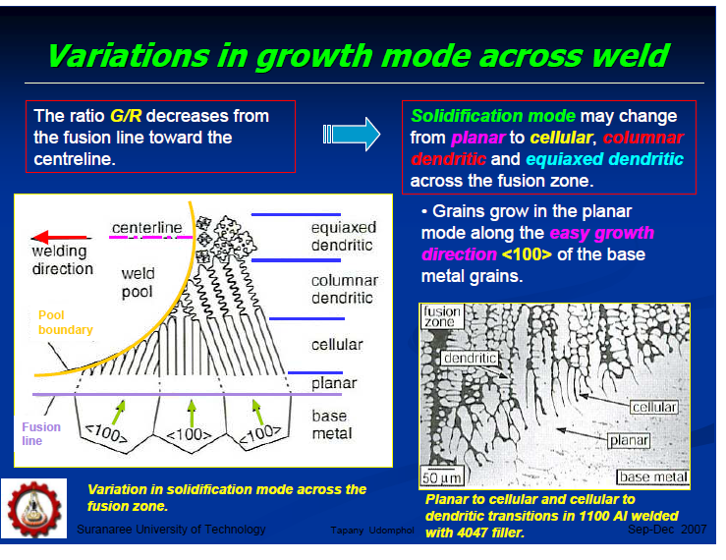
Modes of solidification

Slide 17
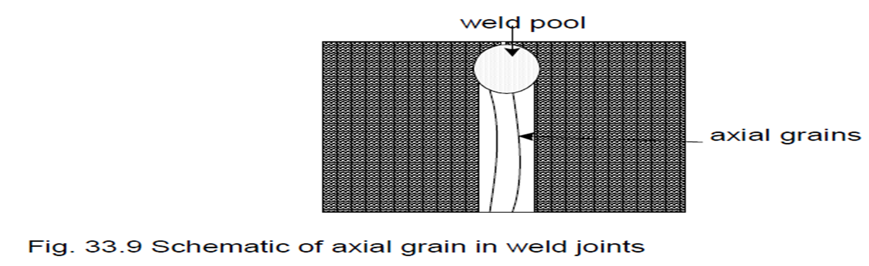
Effect of welding parameters on modes of solidification
-In addition to microstructural variations in the weld, macroscopic changes also occur in weld, which are governed by welding parameters (heat input, welding speed) reveals two types of grains based on their orientation:
a) columnar grain and b) axial grain
-Columnar grains generally grow perpendicular to the fusion boundary in direction opposite the heat flow
-Axial grains grow -Axially in the direction of welding The axial grains weaken the weld and increase the solidification cracking tendency therefore effort should made to modify the orientation of axial grains.

Slide 18
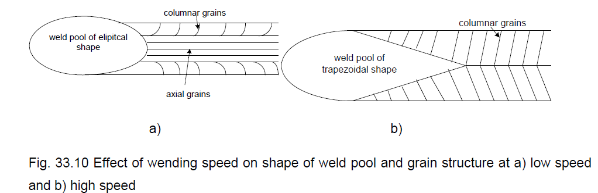
Effect of welding speed on grain structure of the weld
-Low welding speed ( Fig. a) results in elliptical shape weld pool and produces curved columnar grain with better distribution of alloying elements which in turn lowers solidification cracking tendency of the weld than weld produced using high welding speed
-High welding speed, ( Fig. b) produces like a tear drop shape weld pool becomes and grains are mostly perpendicular to the fusion boundary of the weld. In this case alloying elements are mostly segregated along the weld centerline,

Slide 19
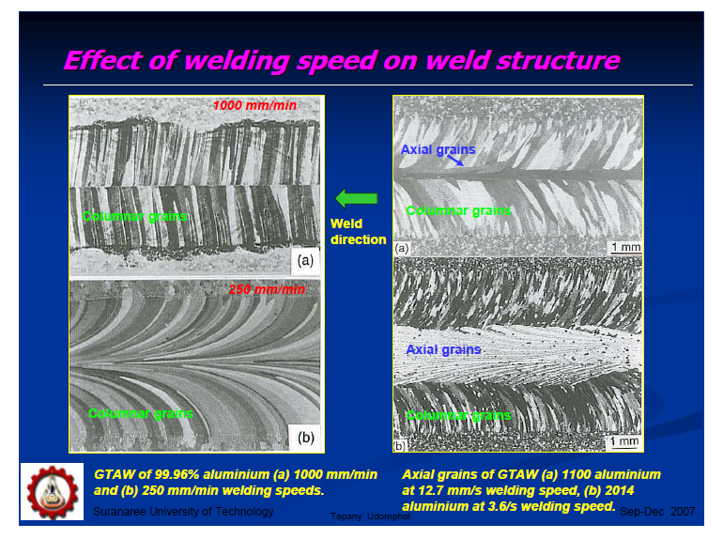
Effect of welding speed on grain structure of the weld

